Slide 1


Top 5 Architecture Patterns
Adding Tools to the Toolbox

Slide 2


Slide 3

Jim Everett
Developer, Architect, Software Enthusiast
Experience
HMBer
Married father of 2
Software Enthusiast
17 years of .NET Experience
Enterprise Architect
Developer
Scrum Master
Life Learner
 https://twitter.com/CognitiveBurden
 https://github.com/cognitiveburden
 cognitiveburden@gmail.com

Slide 4

What is your favorite Architecture?

Slide 5
Introduction
Architecture Patterns
Layered
Microservices
Event-Driven
Space-Based
Microkernel
Discuss several well known architectural patterns with their pros and cons. The goal is for the listener to have an understanding of the patterns and be more informed on the types of architecture when faced with architectural decisions.
Notes:
Material: Going to go over 5 different architectures *say each one*
Format: Introduction, Description, Pros & Cons
The first pattern we will be going over is…

Slide 6
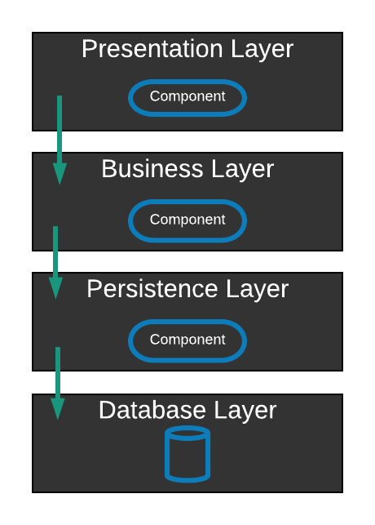

Layered Architecture
MMM…Tastes so good.
Typically:
Presentation
Business
Persistence
Database
Notes:
Components are layered horizontal in this pattern.
Usually consists of four components: the presentation layer, the business layer, the persistence layer, and the database layer.
Can have three layers for smaller applications
The business layer and persistence layer are combined, where the persistence logic is included in the business layer.
Can have more than four layers for larger applications.
Presentation layer: handles UI and browser communication logic.
Business layer: contains the business logic for the application.
Persistence layer: how we’re mapping our business objects into our datastore.
Database layer: where the application data is located.
Important concepts:
Separation of concerns: the idea that the components will only have logic related to that specific layer. So the presentation layer only has logic dealing with the presentation, and the business layer only deals with the business logic.
Closed: as a request moves from layer to layer, it must go through the layer below it to get to the next layer.
So if you are moving from the presentation layer to the persistence layer and the presentation, business, and persistence layers are all closed, then you need to go through the business layer to get to the persistence layer. Closed layers means you must pass through them, open means you can skip over layers.
Layers of isolation: when changes are made in one layer, they should not (usually) impact the other layers. This is related to the closed concept because if a layer is closed, it would not contain logic related to other layers. If it does not contain code related to other layers, then if changes are made to one layer, it would not impact the other layers.
This makes layers independent of each other.
If this concept were not in place, then the different layers would be tightly coupled, which makes making changes to the different layers much harder.

Slide 7

Clean, Onion, Hexagonal Architecture
Layered Architecture
Independent of Frameworks
Independent of UI
Independent of Database
Independent of External Integrations
Testable
Notes:
Independent of Frameworks
Testable
Independent of UI
Independent of Database
Independent of External Integrations
The Dependency Rule. This rule says that source code dependencies can only point inwards.

Slide 8
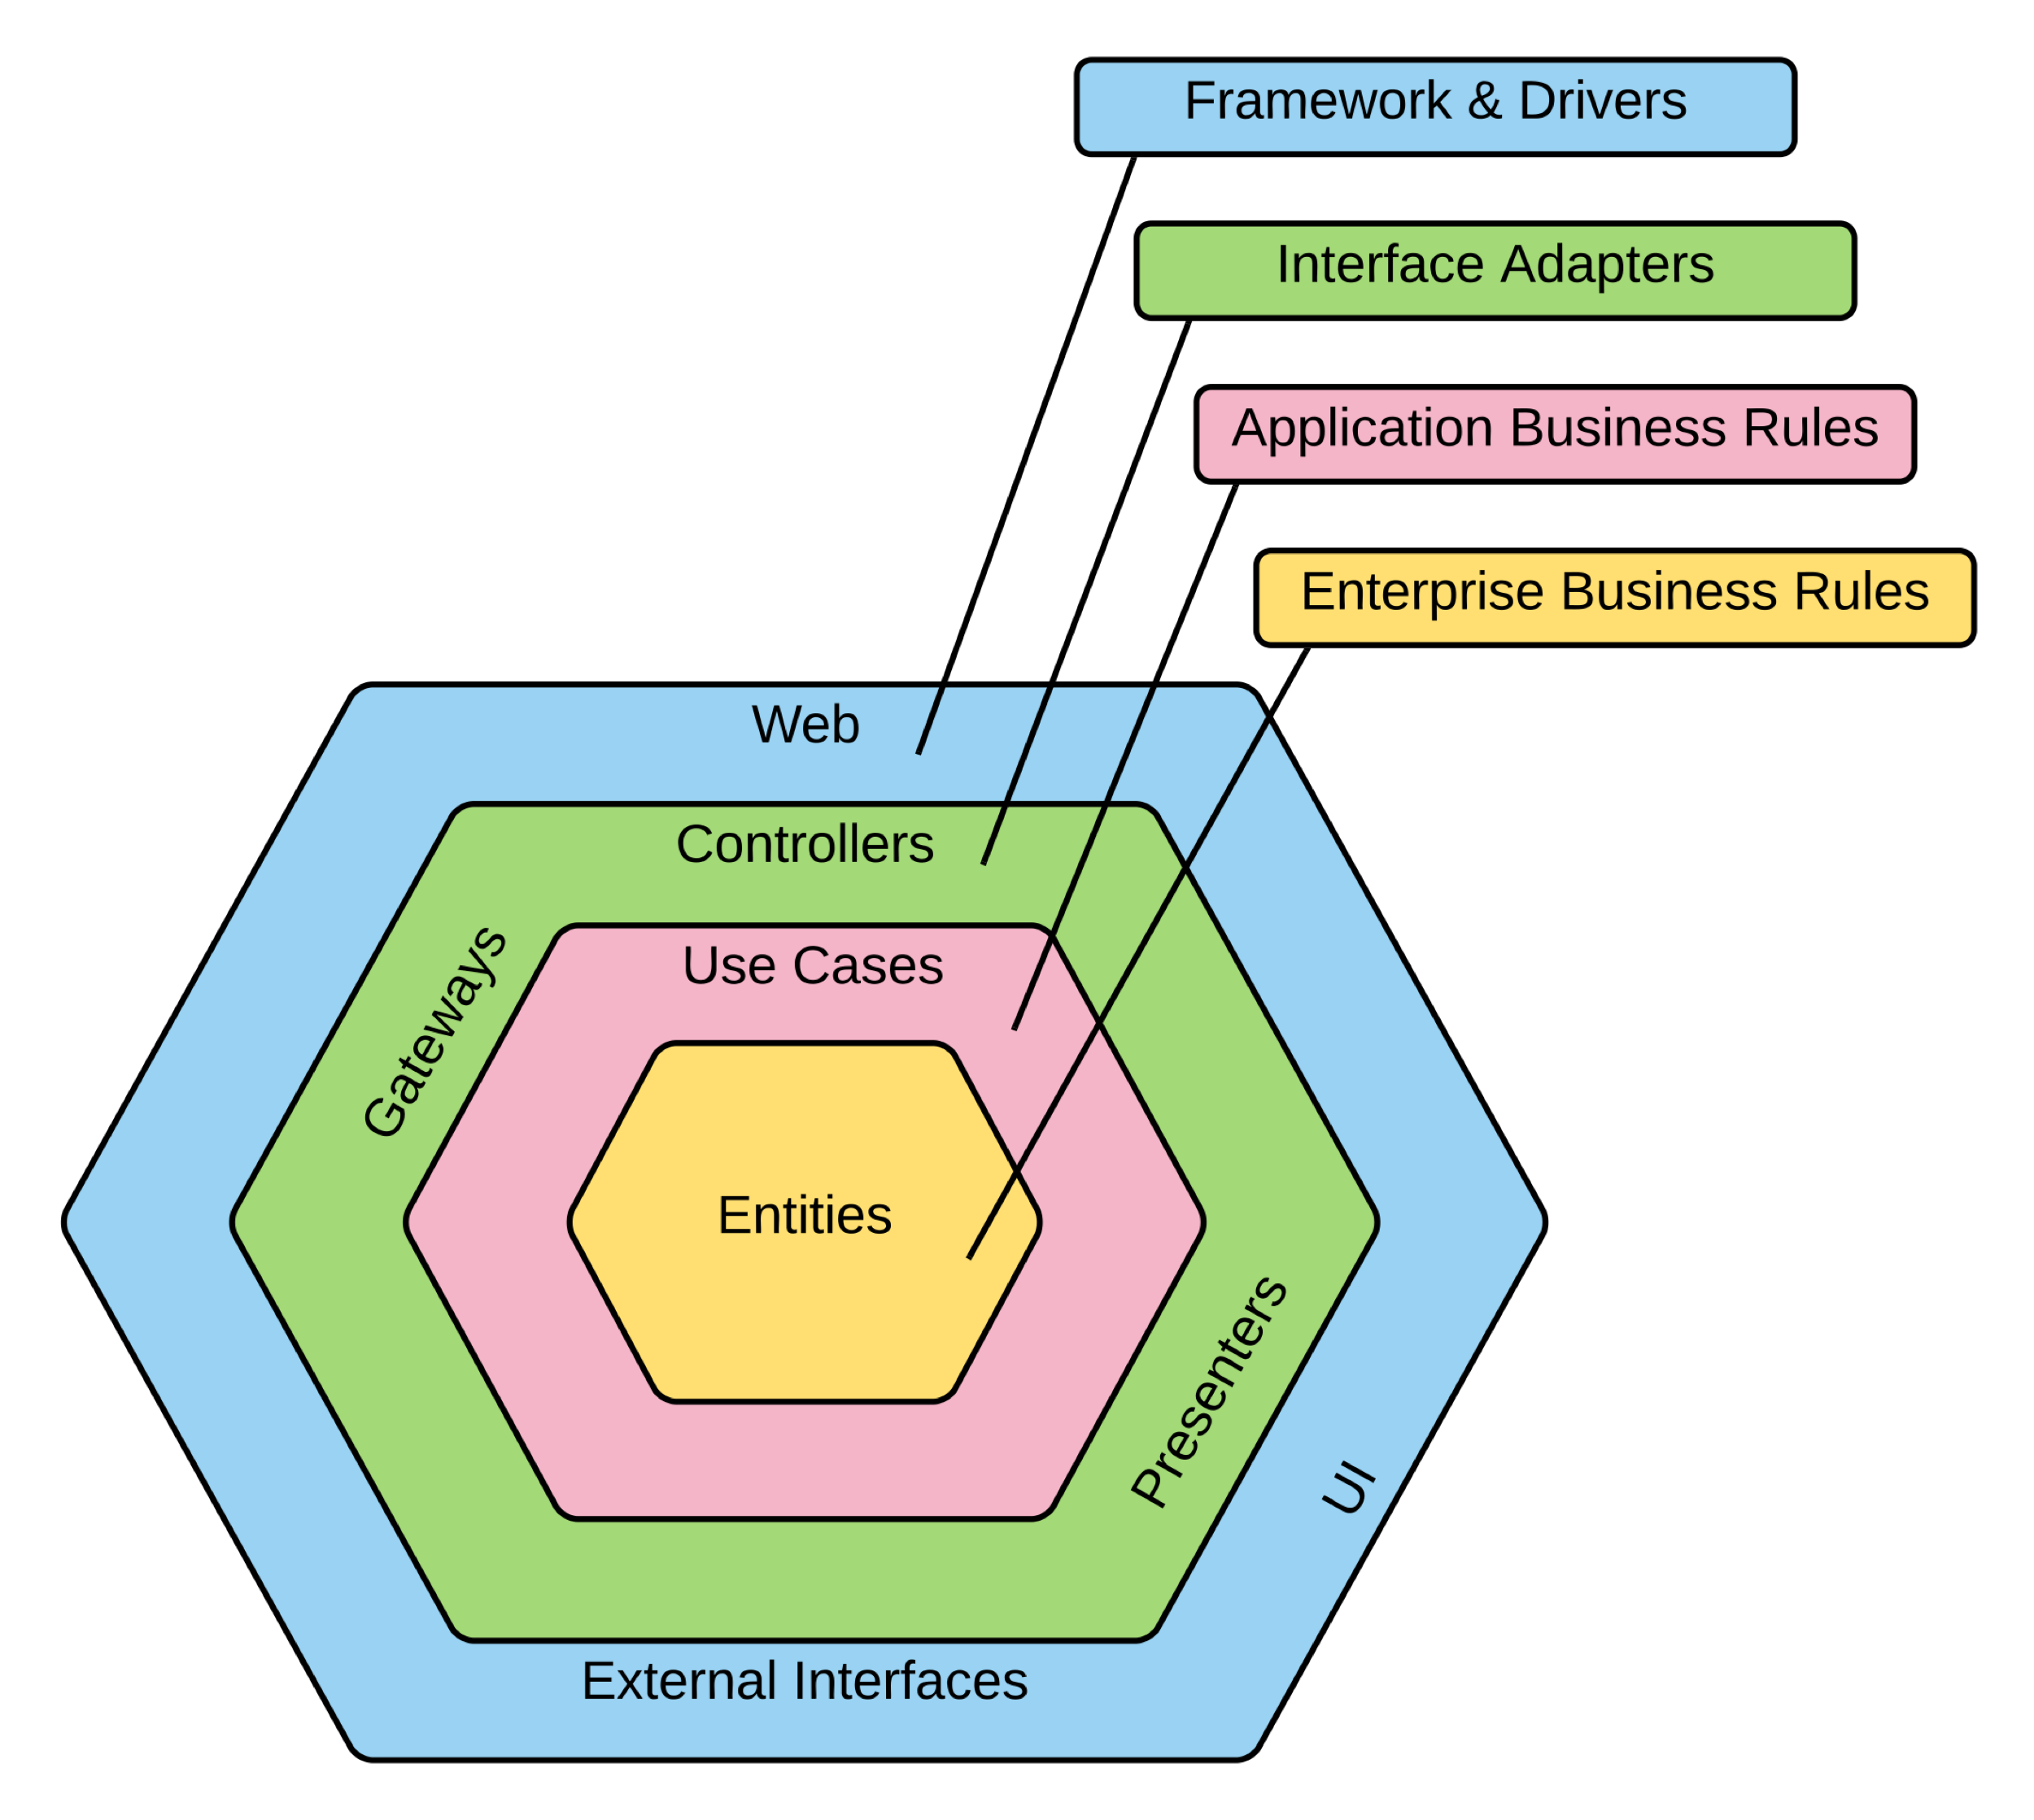
Clean Architecture
Layers
Layers
Framework & Drivers
Interface Adapters
Application Business Rules
Enterprise Business Rules

Slide 9
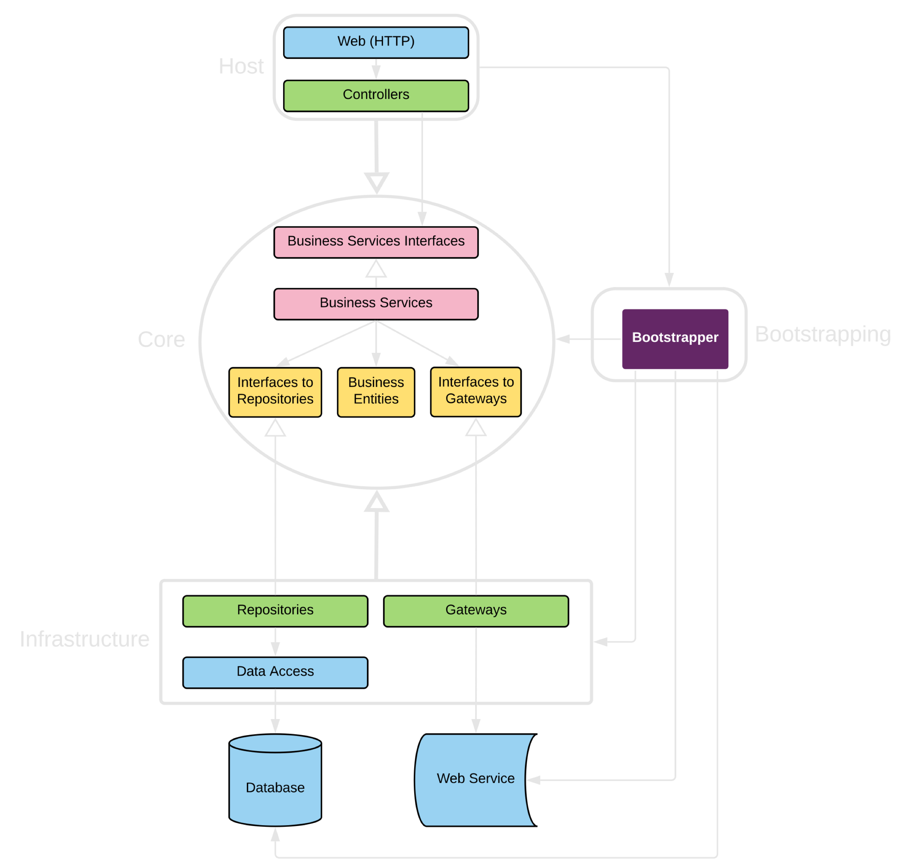
Clean Architecture

Slide 10

Pros & Cons
Layered Architecture
Pros
General Purpose Pattern
Starter Arch for new application
Cons
Sinkhole anti-pattern
Best for Monolithic applications
Notes:
I’m going to go over some pros and cons of this pattern so you might be able to figure out if this architecture is a good fit for your project.
Pro’s and Cons:
General purpose pattern
A good starter architecture for a new application (may not know best pattern to use)
It’s familiar and well known
Nothing inherently bad
Watch out for Sinkhole anti-pattern
Requests flow through layers which are a pass through (no logic)
Ex. Getting customer data for a user. Presentation calls database, so it passes through the business and persistence layer and does nothing (no logic).
Think 80/20 rule with sink-hole (having only 20% of calls be pass through and 80% having some business logic)
If 80 % is pass through consider opening up your layers so they can skip a layer.
Will make changing code harder
Best suited for Monolithic applications

Slide 11
Pattern Analysis
Layered Architecture


Agility
Performance
Changes can be isolated to a layer, it is time-consuming to make changes due to Monolithic nature.
Pattern does not lend it self to performance because every request must go through multiple layers.


Ease of Deployment
Scalability
One small change can result in redeploying the entire application.
Due to tightly coupled monolithic design is difficult to scale. Large granularity of layers makes expensive to scale.


Testability
Ease of Development
Because components belong to specific layer, other layers can be faked, making it easy to test.
Pattern is well known and not overly complex. Matches well with companies communication patterns, Conway’s Law.
Notes:
Up next is…

Slide 12



Event-Driven Architecture
What’s Going On
Mediator
Distributed Async Pattern
Composed of highly decoupled, single purpose event processing components that asynchronously receive and process events.
Broker
Notes:
Popular distributed asynchronous architecture pattern used to create highly scalable applications.
Highly adaptable; can be used for small and large applications.
Made up of highly decoupled, single-purpose event processing components that asynchronously receive and process events.
Consists of two topologies: mediator and broker topologies.
/////
Lack of atomic transactions for single business process.
Which events can run independently and which can’t.
Difficultly in creating, maintaining, and governing of the event-processor component contracts.

Slide 13
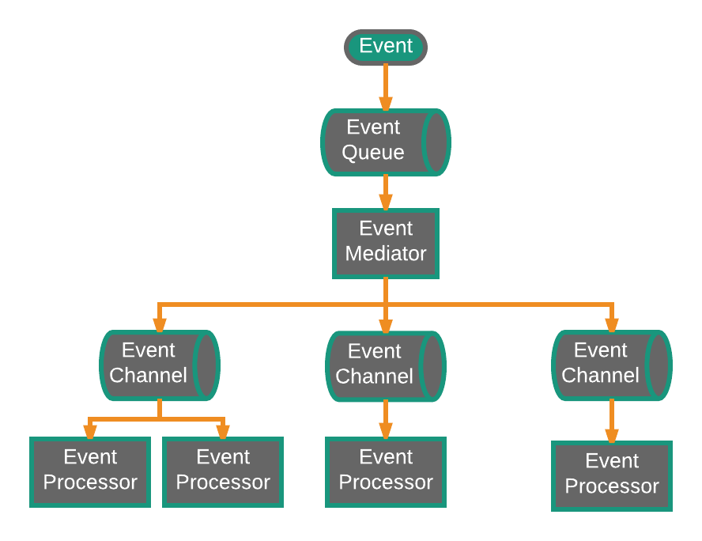
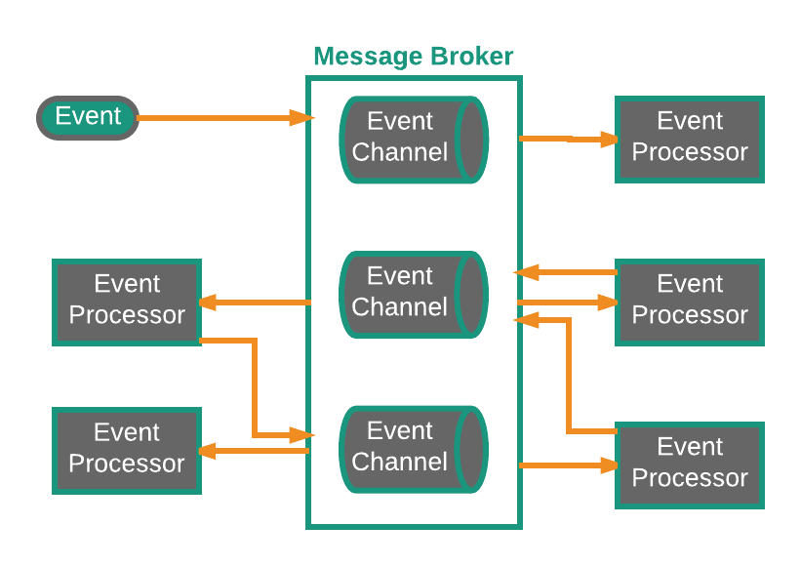
Mediator vs Broker
Orchestration vs Choreography
Mediator / Orchestrator
Broker / Choreography
Notes:
This topic comes up in DISTRIBUTED TRANSACTIONS
Mediator used when steps need to happen in order and therefore need orchestration.
Think Spring Integration, MULE ESB
//Logic in the middle of your infrastructure
Four components are involved with the mediator topology: event queues, an event mediator, event channels, and event processors.
The event queue is what the events are loaded on to.
The event mediator receives the event from the event queue and orchestrates that event by sending asynchronous events to the event channels.
Event processors listen on the channels. They take the event from the mediator and execute business logic to process the event.
//No Business logic in Event Mediator (in processor)
2 types of events…Initial & Processing
The event mediator takes the initial event
The event processor takes the processing event(s) which the event mediator generated from the initial event.
Useful if multiple steps and orchestration for event processing.
Ex. Moving and have to deal with your insurance.
Initial event: relocation event.
Event mediator role: create processing event CHANGE SPOT(change address, recalculate quote, update claims, adjust claims, notify insured.) and send to event channel
Event processor takes event from event channel (change address, recalculate quote, etc.) for each event
This would continue until all events from the initial event have been processed.
Broker
ActiveMQ, RabbitMQ
For Simple workflow, no orchestration needed
Two components are involved with the broker topology: a broker and an event processor.
There is no central event mediator, like in the mediator topology. Instead, it is decentralized.
The message flow is distributed across the event processor in a chain-like way through a message broker.
Each event processor processes an event and publishes a new event saying what action it performed.
The new event is published to the broker, which is then picked up by another processor.
The business logic is performed by chaining the events.
Ex. Event processor that balances a portfolio of stocks receives an initial event called split stock.
Event processor rebalances portfolio
Publishes new event to broker called rebalance portfolio
Picked up by different event processor.

Slide 14
Pattern Analysis
Event-Driven Architecture


Agility
Performance
Able to respond quickly to constantly changing environment. Since event-processor components are single purpose and decoupled, changes are isolated and quickly change without impacting others.
Possible that will not perform well with all the messaging infrastructure, asynchronous capabilities, decoupled parallel execution outweighs cost.


Ease of Deployment
Scalability
Relatively easy to deploy because decoupled. Broker easier to deploy than mediator.
Naturally achieved through highly independent and decoupled event processors.


Testability
Ease of Development
Unit testing not difficult, but testing is complicated by async nature of pattern.
Development and can be complicated due to async nature of the pattern. Advanced error handling, unresponsive event processors, and failed brokers are complicated problems.
Notes:
In General this is type of pattern you need to put in ideas of correlation id to track
Next, we will be going over…

Slide 15
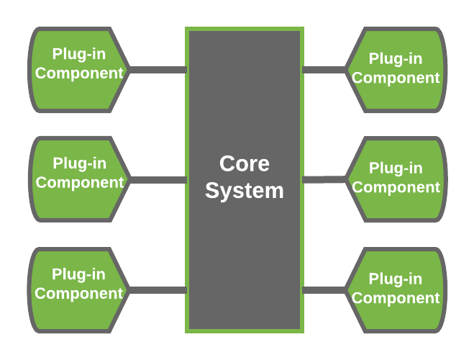
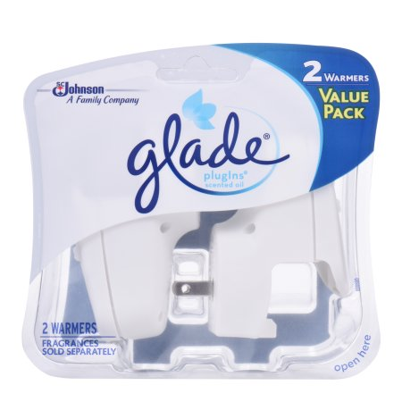
Microkernel Architecture
Plug it in, plug it in
Great for Products
Add features as plug-ins
Extensible
Feature Separation
Feature Isolation
Notes:
Known as plug-in architecture
With this pattern, you can add “plug-ins” to the core functionality of the application.
//Packaged and made available for download //software internal or external
Application logic is divided between independent plug-in modules and the basic core system, providing extensibility, flexibility, and isolation of application features and custom processing logic
provides great support for evolutionary design and incremental development
As for how it works…

Slide 16


Core vs Plugin
Microkernel

Core

Plug-in

Minimal viable business logic to make application valuable
Implements a plug-in registry
Connected via OSGi, messaging, web services, point-to-point
Remain independent of other plug-ins
Notes:
Consists of two components: the core system and plug-in modules.
The core system contains only the minimal functionality that the application needs to run.
For businesses, the core system could be considered the core business logic, and the plugins could be considered the special cases, unique rules, or complex processing needed to be added to the core functionality.
Multiple plugins can be used, but usually, the plugins are not related to each other and are standalone.
The core system has to have knowledge of the plugins and has to be able to get to them to use them; this is usually done through a registry of plugins.
Ex. An IDE, like VS Code or Eclipse. Both contain core functionality, which is enough for the application to have basic features (like…). If you want to extend the functionality, you can install extensions (which function like plugins). For example, Vue file highlighting maybe isn’t included in VS code by default, so if you want to work on a Vue project, then you will want this “plugin” added to VS Code so that programming will be easier.
Or chrome extension. Again, working on Vue project and need Vue DevTools to be able to debug. Not included by Chrome by default (and not needed to be able to use Chrome) but adding this plugin would extend Chrome functionality and make debugging your Vue application easier.
//Remember to implement versioning strategy
//Eclipse and modern browsers are examples of microkernel
//Can nest architectural patterns, could use Microkernel within even-driven

Slide 17
Pattern Analysis
Microkernel Architecture


Agility
Performance
Able to respond quickly to constantly changing environment. Changes isolated and implemented quickly through loose coupled plug-in modules.
Not naturally high performance, often perform well because only include features you need.


Ease of Deployment
Scalability
Plug-ins can be added dynamically (hot-deploy).
Core is often smaller in size and deployed as one unit, making it hard to scale.


Testability
Ease of Development
Plug-ins can be tested in isolation and easily mocked by core system.
Requires thoughtful design and contract governance. Contract versioning, plug-in registry, plug-in granularity, and wide array of connectivity choices make complex.
Notes:
Core usually becomes stable quickly
What is core of your system?
Now, we will talk about…

Slide 18
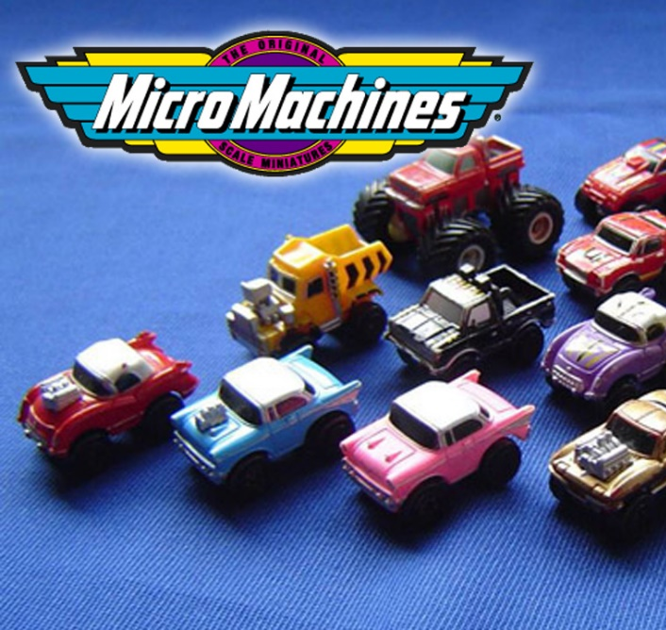
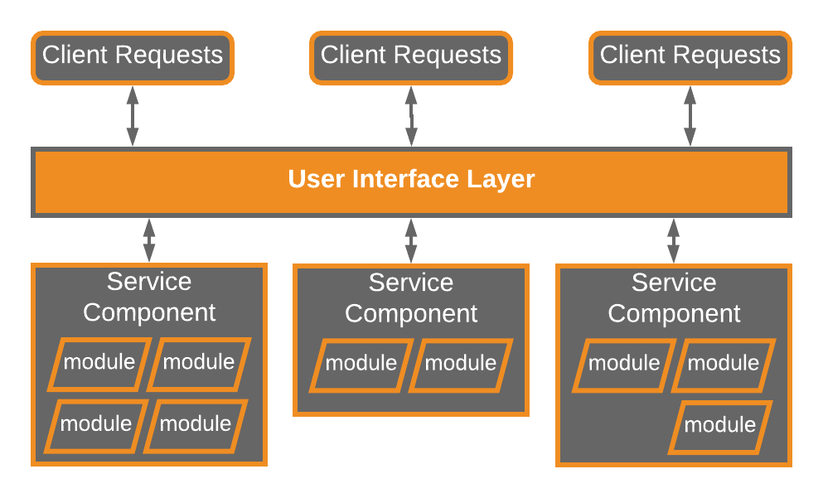
Microservices
Collect them all
Separately deployed units
Distributed Architecture
Easier deployment due to isolation
Microservice as a service component
Microservice has a single purpose
Evolution of monolithic and SOA
Notes:
Core concepts:
Each component is deployed as a separate unit.
Makes deployment easier.
Increases scalability.
Higher degree of component decoupling.
Service components
A service component contains one or more modules (like a Java class) which represents a single-purpose function or an independent portion of a large business application.
It is a distributed architecture.
Each component is fully decoupled from other components.
They are accessed through a remote access protocol.
This pattern came about as a solution to the problems of other architectures.
The need for the microservices architecture was because of continuous delivery
Each component in the microservice architecture can be developed, tested, and deployed without affecting or interfering the other components.
//Distributed architecture
//All components are fully decoupled and accessed through remote access protocol (JMS, AMQP,REST,SOAP,RMI, etc)
There are a few different ways this can be implemented…

Slide 19
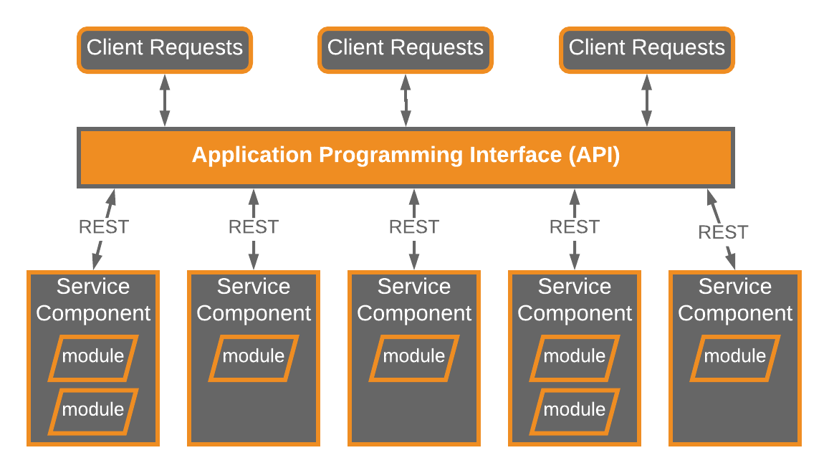
API REST-base Topology
Microservices
Useful for websites
Fine-grained services
REST-based interface
Notes:
Useful for websites that expose small, self-contained individual services through an API.
Service components are fine-grained. The components are accessed through a REST-based interface.
This interface is separate from the component.
It is a web-based API.
They contain one to two modules that perform business logic independently from other components.
Examples of this topology include some of the common single-purpose cloud-based RESTful web services found by Yahoo, Google, and Amazon.

Slide 20
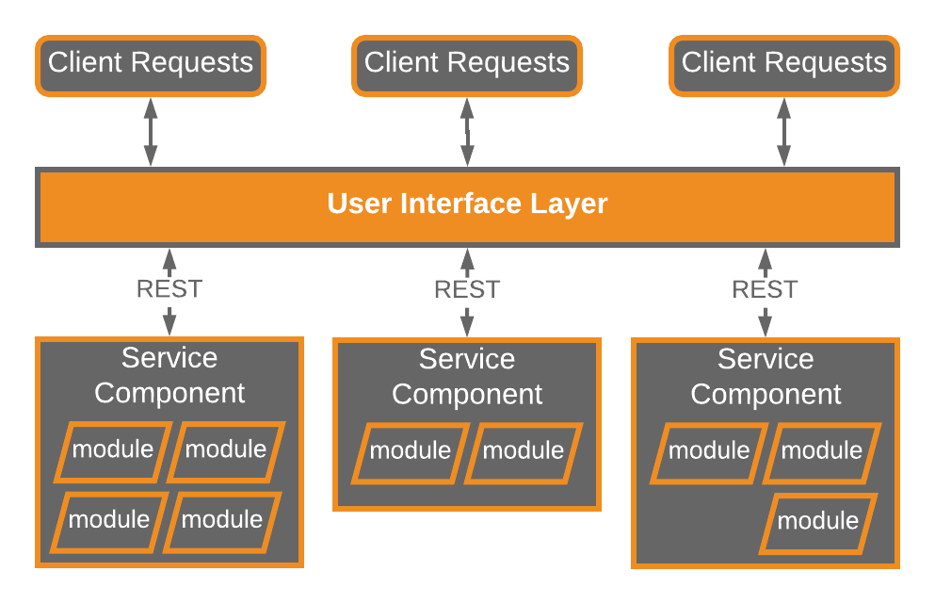
Application REST-base Topology
Microservices
Useful for fat-client apps
Through screen not API
Coarse-grained components
REST-based interface
Notes:
Requests are received through a web-based or fat-client application screen.
The user interface is separate from the other services. It accesses the service components (which are deployed separately) remotely through a REST-based interface.
Components are more coarse-grained as compared to the API REST-based topology.
Represent small portion of the business rather than fined-grained, single-action services
This topology is common for small to medium-sized business applications that have a relatively low degree of complexity.

Slide 21
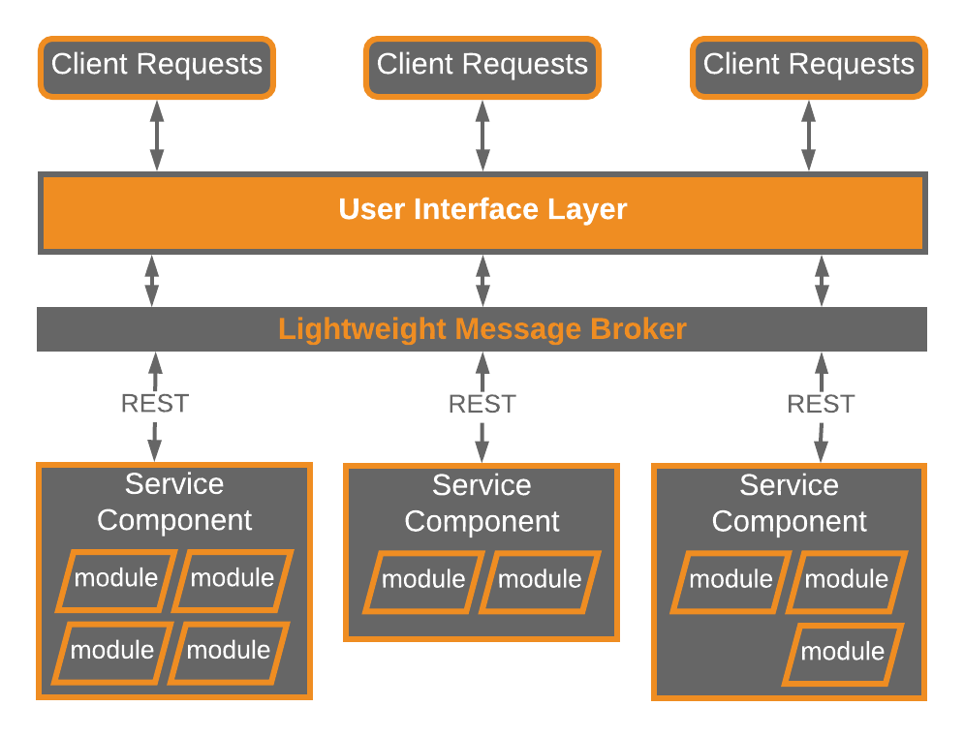
Centralized Messaging Topology
Microservices
Remote Access via Message Broker
NOT SOA-Lite
Coarse-grained components
REST-based interface
Notes:
lightweight centralized message broker (e.g., ActiveMQ, HornetQ, etc.).
larger business applications
requiring more sophisticated control over the transport layer between the user interface and the service components
benefits over the simple REST-based topology
advanced queuing mechanisms,
asynchronous messaging,
monitoring,
error handling,
better overall load balancing and scalability
The central broker bottleneck issues are addressed through broker clustering and broker federation.
Broker federation: where a single broker instance is split into multiple broker instances, which divides the message throughput load based on the functional areas of the system.

Slide 22

Granularity of Service Components
Avoid Dependencies and Orchestration
L
Too Coarse
May not realize benefits of deployment, scalability, testability, & loose coupling.
S
Too Fine
Leads to service orchestration, which turns lean microservices into heavy SOA, with complexity, confusion, expense, & cruft.
M
Just Right
Get all of the agility, deploy-ability, testability, scalability, & develop-ability
Notes:
If too course-grained, you won’t get the benefits of this pattern (deployment, scalability, testability, and loose coupling)
if you find you need to perform inter-service communication between service components to process a single request, chances are your service components are either too fine-grained or they are not partitioned correctly from a business functionality standpoint
Violate DRY to keep services independent
If you can’t avoid service-component orchestration no matter the level of service component granularity, you might want to pick a different architecture because this might not be the one for you.

Slide 23
Pattern Analysis
Microservices Architecture


Agility
Performance
Able to respond quickly to constantly changing environment. Separate deployed units, changes limited to single service component.
Possible to create performant solution, but pattern does not lend itself to performance, due to distributed nature of pattern.


Ease of Deployment
Scalability
Easy to deploy due to the decoupled nature of event-processing components.
Because app is split into separate deployment unit, each service can be scaled.


Testability
Ease of Development
Isolation of business functionality into independent applications makes easy to test. Regression testing a single service is possible.
Due to isolation of distinct service components , development is focused on smaller scope. Less chance a developer’s changes will impact other service components.
Notes:
Core usually becomes stable quickly
What is core of your system?
The final pattern we will be discussing is…

Slide 24

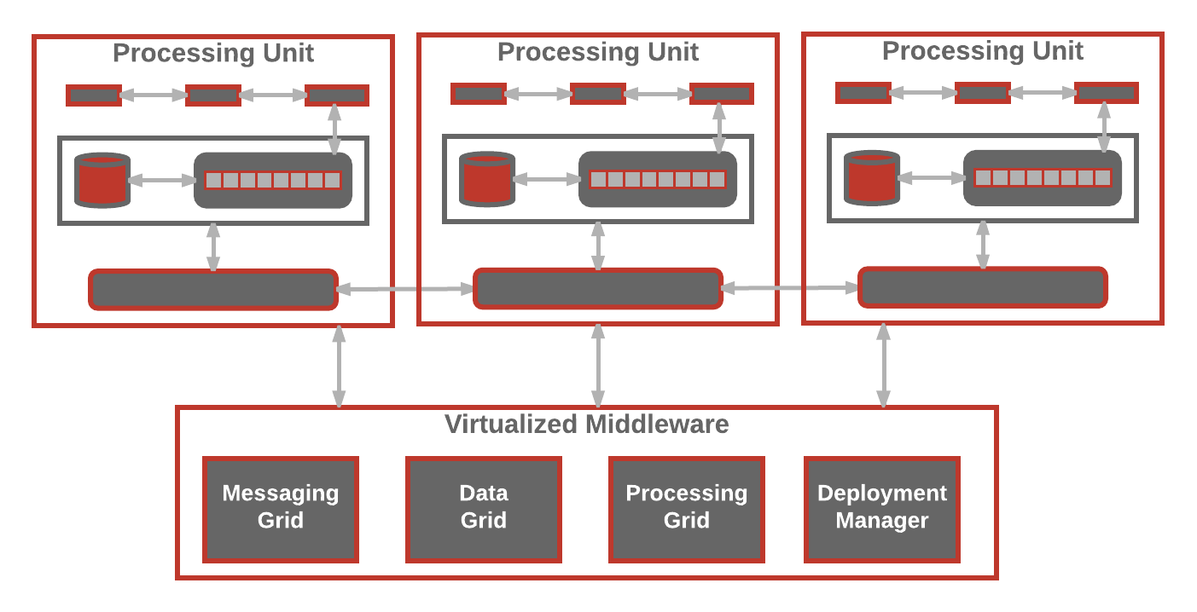
Space-Based Architecture
Build it
Solve Scalability issues
Address concurrency issues
For high concurrent user volumes
Aka the cloud architecture pattern
Remove central DB
Use replicated in memory data grids
Complex & Expensive
Notes:
name from the concept of tuple space, the idea of distributed shared memory
providing near-infinite scalability within the application.
Fixes bottleneck associated with the database layer of a web application, since the database is usually the final limiting factor in a high-volume application.
Solves scalability and concurrency issues.
A good architecture for applications that have variable and unpredictable concurrent user volumes.
Application data is kept in memory and replicated among the active processing units.
Processing units can be dynamically started and shut down depending on volume.
No central database, so the database bottleneck is removed.

Slide 25
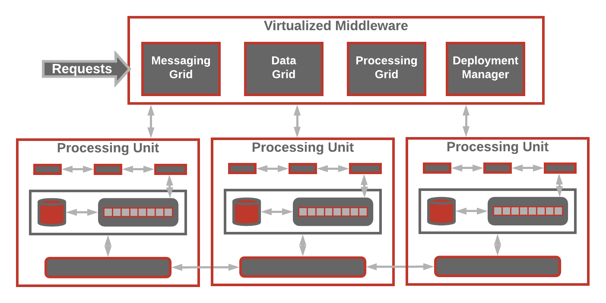
Overview
Space-Based Architecture
Notes:
Here is an overview of the components:
Two components in this architecture: a processing unit and virtualized middleware.
The contents of the processing unit varies based on the type of application—smaller web-based applications would likely be deployed into a single processing unit, whereas larger applications may split the application functionality into multiple processing units based on the functional areas of the application.
The virtualized-middleware component handles housekeeping and communications
An example:
A website that receive a request from a browser and performs some sort of action, so like a bidding auction site. The website would receive bids from users through a browser request. The application would get a bid for an item, record that bid with a timestamp, and update the latest bid information for the item, and send the information back to the browser.

Slide 26
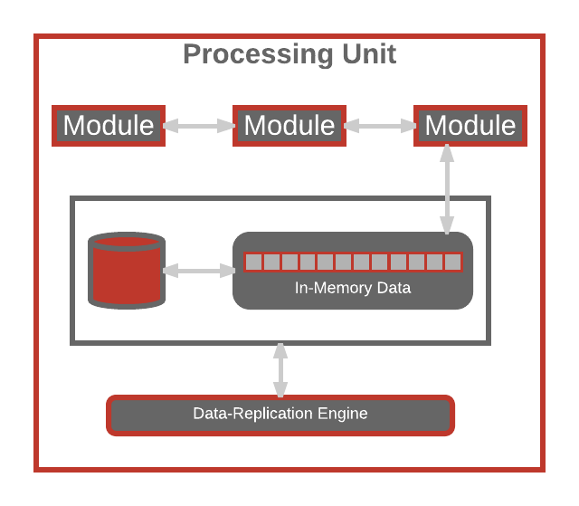
Processing Unit
Space-Based Architecture
Application logic in modules
In-memory data grid
Optional async persistence store
Data Replication Engine
Notes:
To go a little deeper into the processing unit:
Processing unit: Contains the application modules, an in-memory data grid, an optional asynchronous persistent store for failover, and a replication engine used by the virtualized middleware to replicate data changes made by one processing unit to other active processing units.

Slide 27
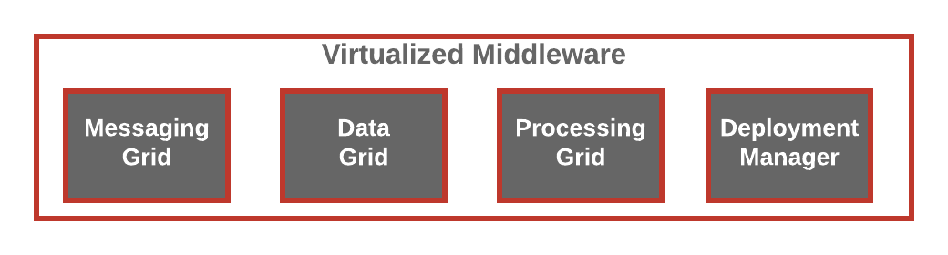
Virtualized Middleware
Space-Based Architecture
Message Grid
Data Grid
Processing Grid
Deployment Manager
Manage input requests
Manage Session
Determine which active processing unit to use
Scale of complexity
Manages data replication
Talks to each replicator
Replication in parallel async
Optional component
Manages distributed requests
Coordinates processing units
Orchestrates
Manages startup/shutdown of processing units
Monitors response times & user loads
If load increases start new processing unit
Notes:
Contains 3-4 different components:
Messaging grid: manages input requests and session information. It determines which processing components are available to receive the request and forwards it to that processing component.
Data grid: most important component. It interacts with the data replication engine in each processing unit to manage the data replication between processing units when updates occur.
Done in parallel asynchronously and very quickly.
Processing grid: optional.
Manages distributed request processing when there are multiple processing units.
Deployment manager: manages startup and shutdown of processing units based on user load.

Slide 28
Pattern Analysis
Space-Based Architecture


Agility
Performance
Because processing units can be brought up/down quickly.
Achieved by in-memory data access and caching build into pattern.


Ease of Deployment
Scalability
While not decoupled or distributed, sophisticated cloud-based tools allow for easy push button deploy.
Achieved by not depending on centralized database, which is often the limiting bottleneck.


Testability
Ease of Development
Expensive and difficult to create user load to test architecture.
Complex caching and in-memory data grids make it difficult to develop. In addition, need to be diligent watchers of performance issues being introduced.

Slide 29




Review
Event Driven
Microservice
Layered
Microkernel Plug-in
Space-Based
Notes:
MODERN Architecture are a mix of all these architectural styles and for each scenario you should pick the best one.

Slide 30

Contact Information
 https://twitter.com/CognitiveBurden
 https://github.com/cognitiveburden
 cognitiveburden@gmail.com

